Slide 1
http
Web Application
Browser
html

Slide 2
Http
Web Service 1
XML
Web Service 2
{ Language: .NET, OS: Windows }
{ Language: Java, OS: Linux }

Slide 3
SOAP ENVELOPE
Header
Optional Data
Header
Optional Data
Body
Application Data
Body
Application Data
Body
Application Data
Body
Application Data

Slide 4
Java
Hibernate
SQL

Slide 5
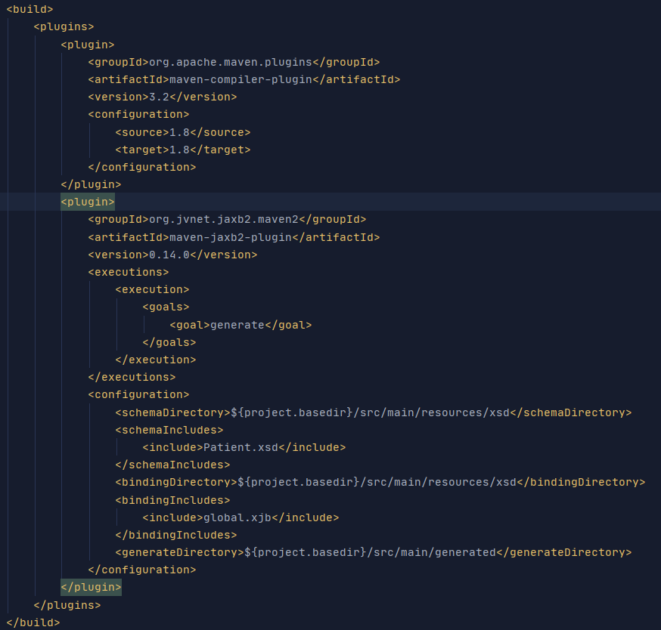
1
2
1
2
3

Slide 6
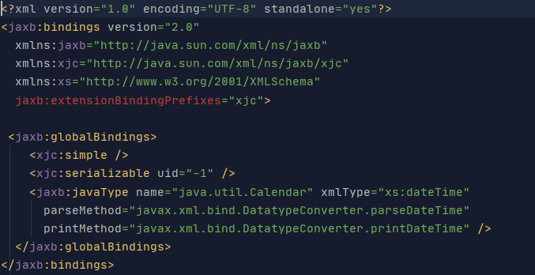
1
1
2

Slide 7
XML
message
Soap/Rest
Engine
Java Object
WS Endpoint Method

